Slide 1
What’s Behind the Movie Rating?
IMDB Comedy Movie Data Analysis
Group 2: Runhai XU (James)
Zhaohang YAN (Martin)
Shiyu FAN (Leo)

Slide 2
Some Questions
Intro
Are comedy movies hard to get high scores？
Are the past movies better than the current ones？
标题文本预设

Slide 3
Data Overview
Visualization
PART ONE
PART TWO
Contents
CONTENTS
Conclusion
PART FOUR

Slide 4
Data Overview
PART ONE

Slide 5
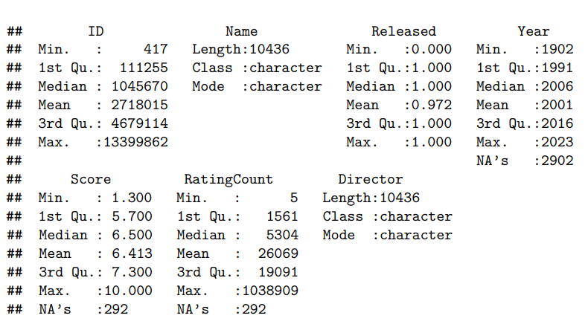
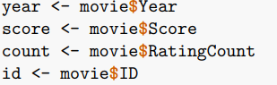
第一部分
PART ONE
Data Overview
IMDB
ID
Released
The digital number of
each movie
1: Released
0: Not released
Score
Year
Movies’ rating on
IMDB website
Release date
RatingCount
Number of reviewers for
this movie

Slide 6
Visualization
PART TWO

Slide 7
Visualization
PART TWO
Rating Count & Score
ID & Score
Year & Score
Anything else?

Slide 8
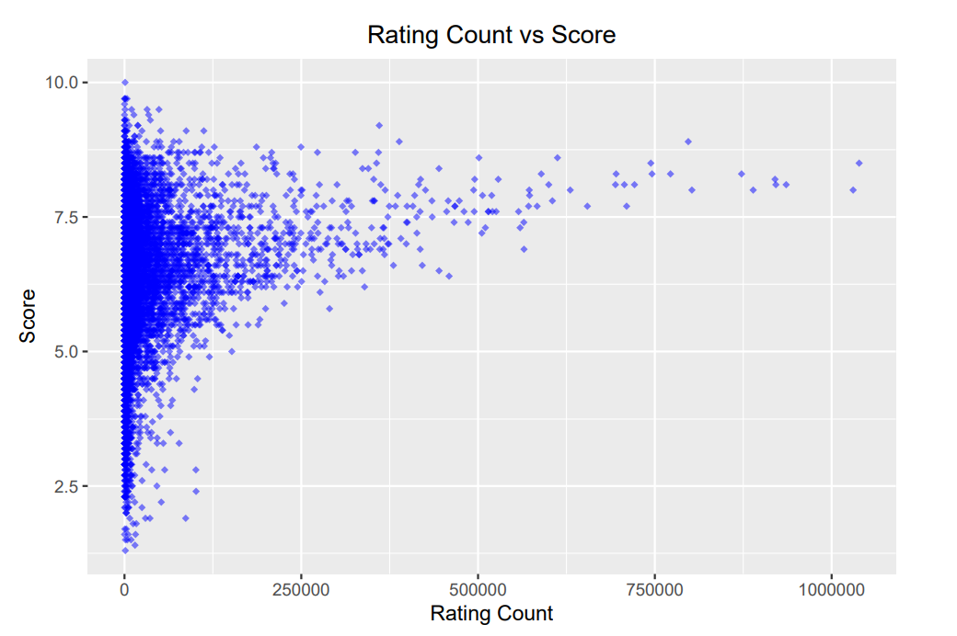
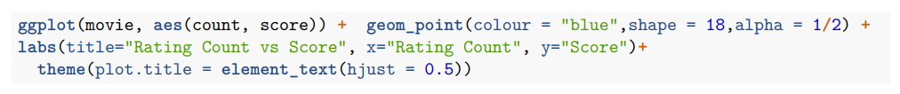
Visualization
PART TWO

Slide 9
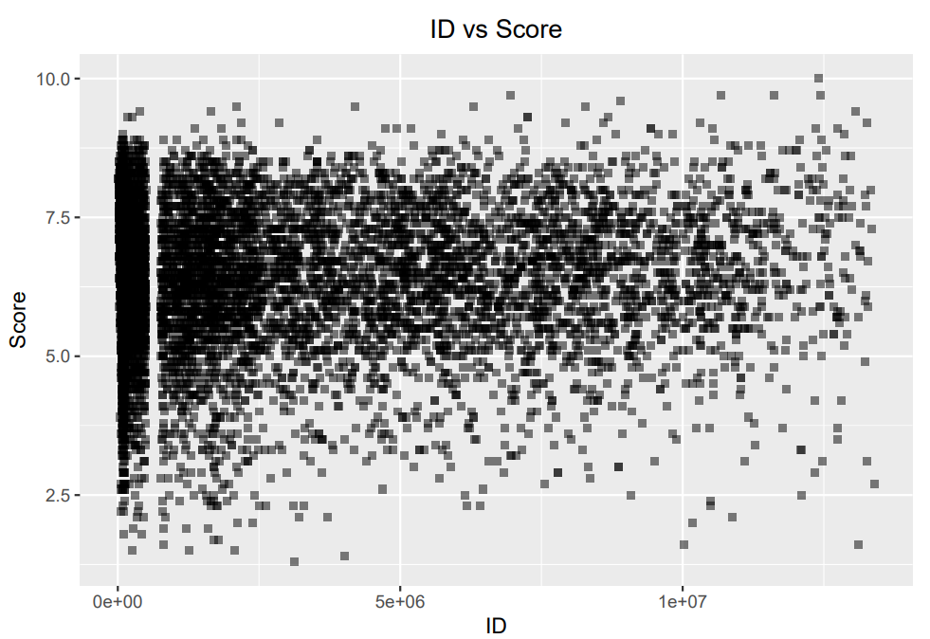
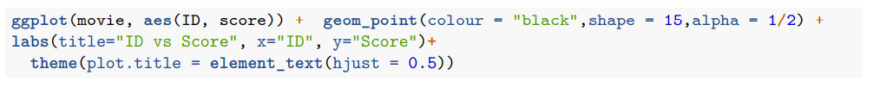
Visualization
PART TWO

Slide 10
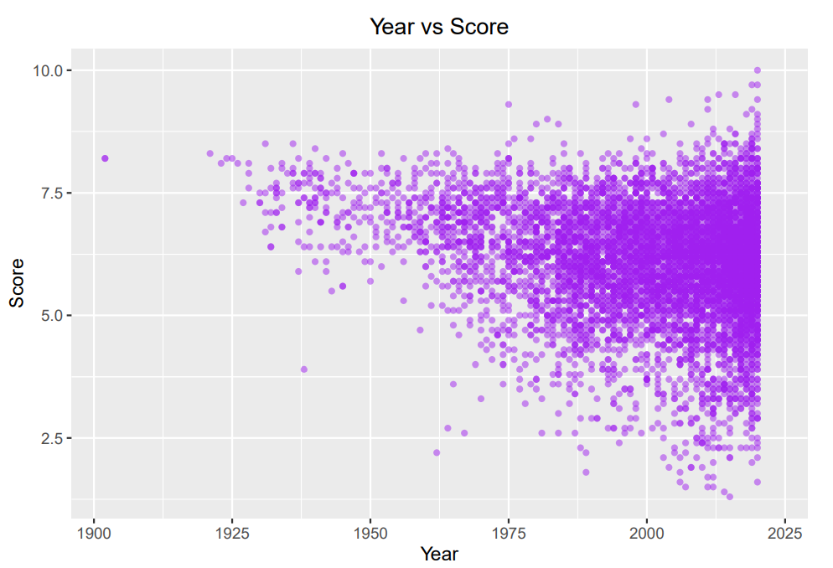
Visualization
PART TWO

Slide 11
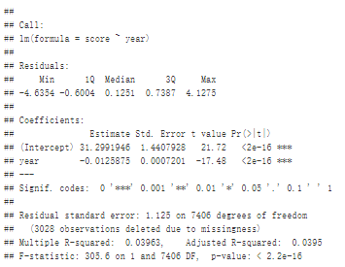
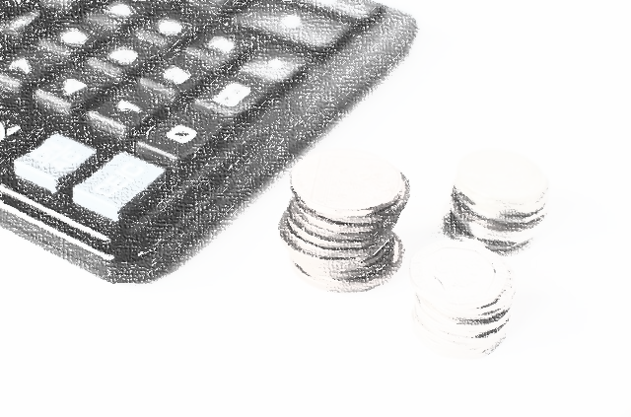
Visualization
PART TWO
Linear Regression Model
SUMMARY

Slide 12

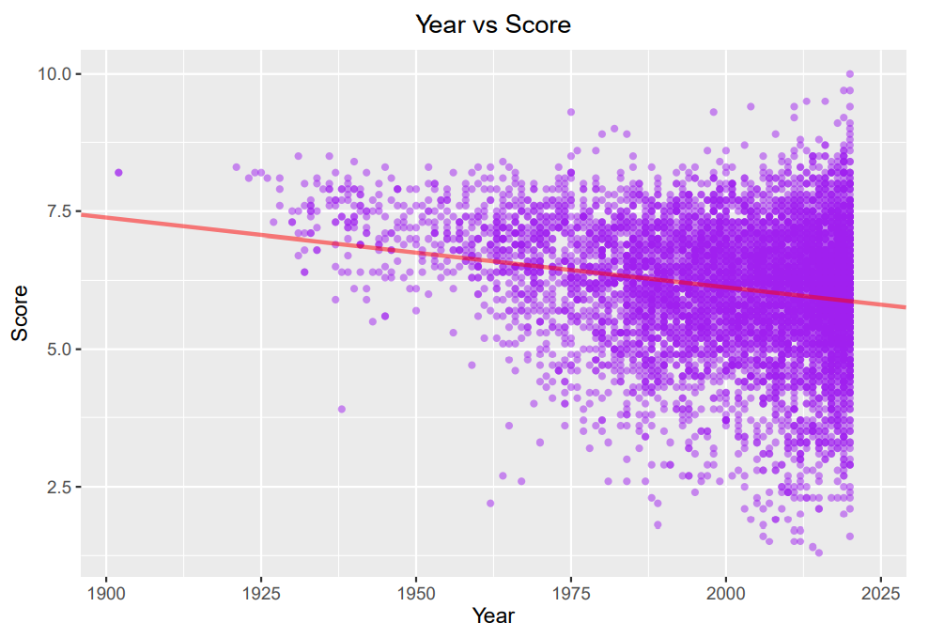
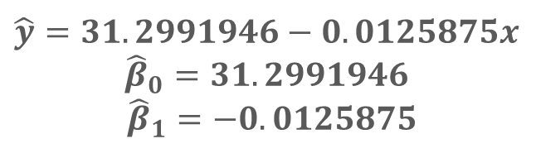
Linear Regression Model
CHART
$$\hat{y}=31.2991946−0.0125875x$$
$${\hat{β}}_{0}=31.2991946$$
${\hat{β}}_{1}=−0.0125875$
Does it appear to be a linear relationship between the two variables?
Visualization
PART TWO

Slide 13

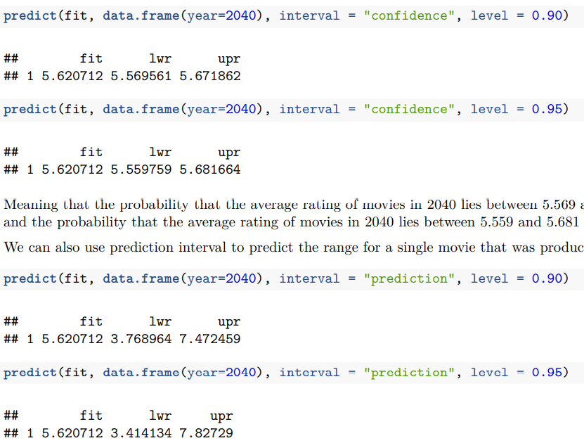
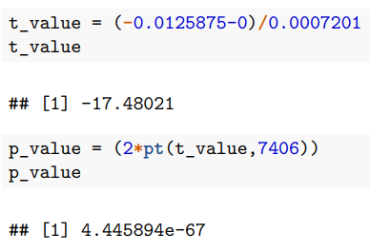
Visualization
PART TWO
Prediction
DETAILS
Verification
DETAILS
Confirmed！

Slide 14
Conclusion
PART THREE
Notes:
PPT模板： www.1ppt.com/moban/ 行业PPT模板：www.1ppt.com/hangye/
节日PPT模板：www.1ppt.com/jieri/ PPT素材： www.1ppt.com/sucai/
PPT背景图片：www.1ppt.com/beijing/ PPT图表： www.1ppt.com/tubiao/
优秀PPT下载：www.1ppt.com/xiazai/ PPT教程： www.1ppt.com/powerpoint/
Word教程： www.1ppt.com/word/ Excel教程： www.1ppt.com/excel/
个人简历： www.1ppt.com/jianli/ PPT课件： www.1ppt.com/kejian/
手抄报： www.1ppt.com/shouchaobao/ 试题下载： www.1ppt.com/shiti/
教案下载： www.1ppt.com/jiaoan/ 字体下载： www.1ppt.com/ziti/

Slide 15
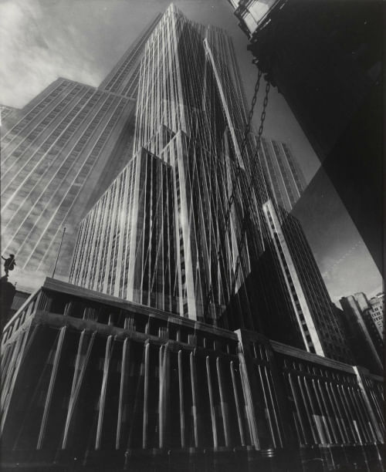
Conlusion
PART THREE
结论blablabla

Slide 16
THANK YOU

